Slide 1
Curling
By: Cole DeBoer

Slide 2
Equipment

Slide 3
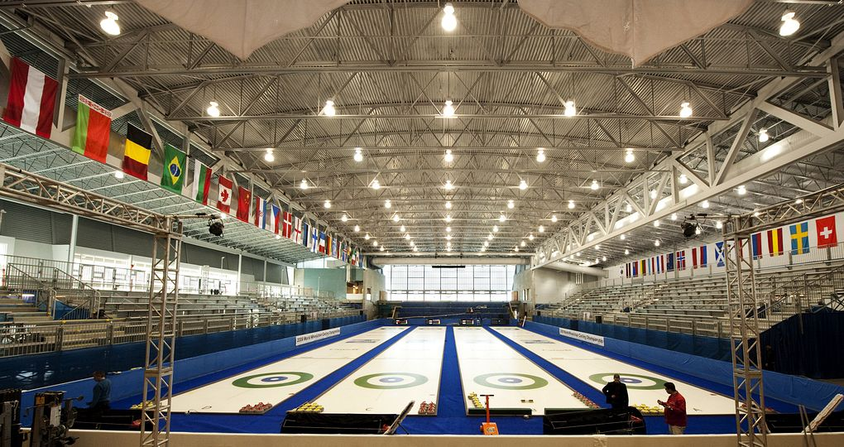
Tournament Play

Slide 4
Player Positions

Slide 5
Rules
10 ends
16 stones
1winner

Slide 6
Works Cited
http://upload.wikimedia.org/wikipedia/commons/0/08/Curling_stones_on_rink_with_visible_pebble.jpg
http://www.i-s-o.info/images/curlingschuhe.jpg
http://lakesidecurling.com/Images/Reactor2CFB.JPG
http://dadoogames.com/curling/images/curling-2010-four-player.png
http://vancouver.ca/PARKS/info/2010Olympics/images/HillcrestVOC2009.jpg
http://www.cindyronzoni.com/wp-content/uploads/2010/01/john-shuster-300x269.jpg

